Slide 1
Wireless IoT and LAN: Wireshark Sniff Project
Group: Buguake
Xiaoyao Luo 5054702
Yifan Li 5145147

Slide 2
Problem Statement
Extract information on chipset and vendor type
Main idea
Extract the MAC address of the Access Points and Stations.

Slide 3
Detailed Process
Extract source addresses from beacon frames and request frames.
Extract the destination addresses from the probe responses.
Compare the addresses with Wireshark manufacturer database to get the vendor types.
Analyse the data we got.

Slide 4
Setup
The project sniffs out all 802.11 frames by setting the built-in network card directly to Monitor mode. Here we use the python3.8 to analyze the collected data. And the Wireshark is running on Linux system (Ubuntu18.04), the python scripts is running on Windows system.

Slide 5
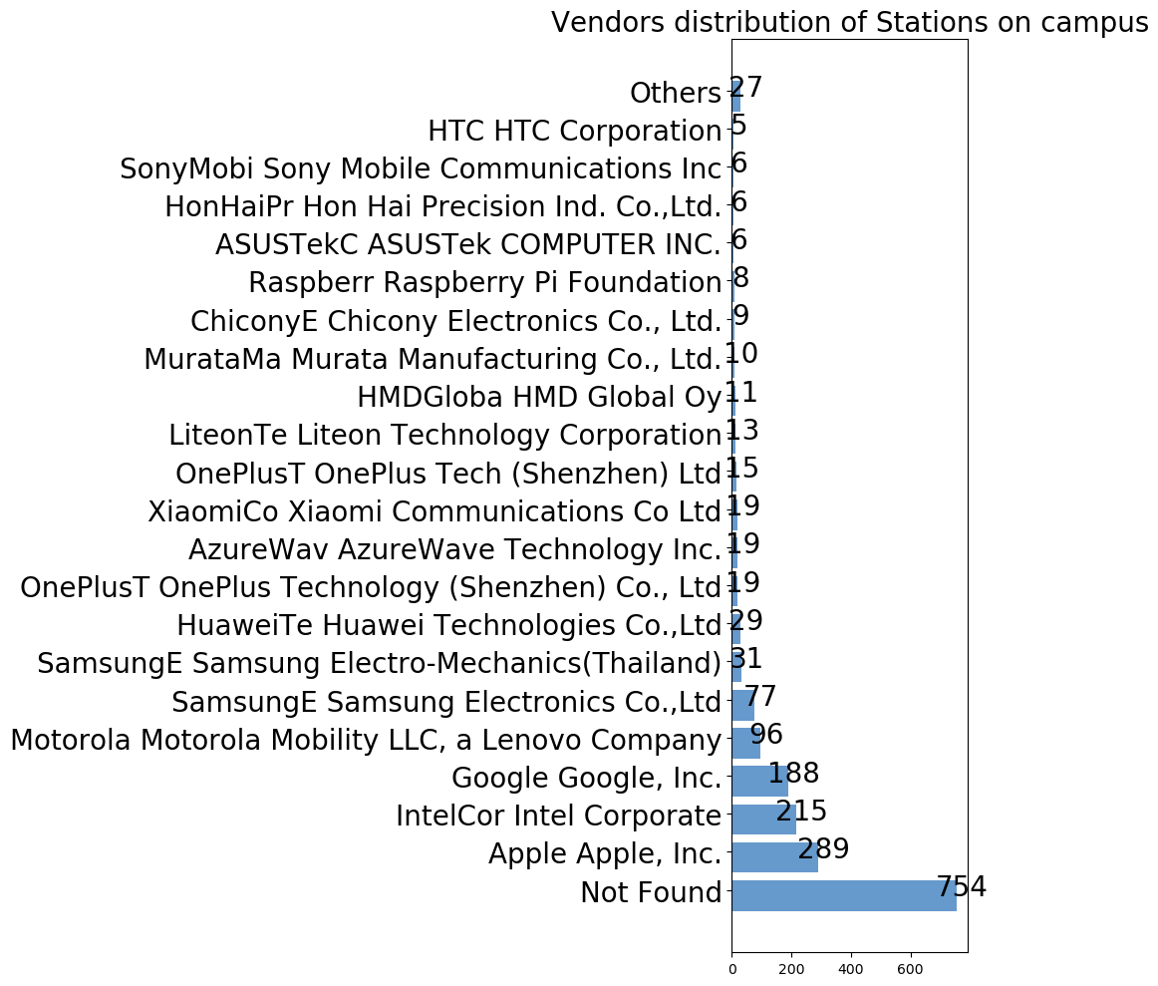
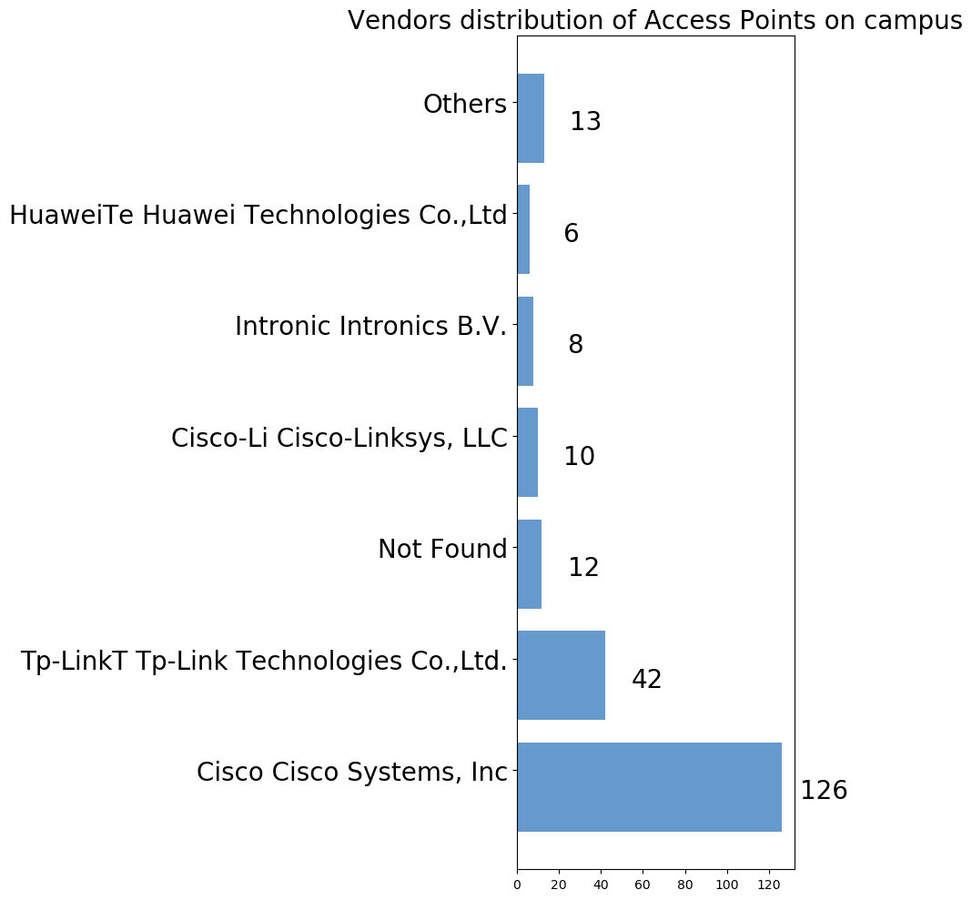
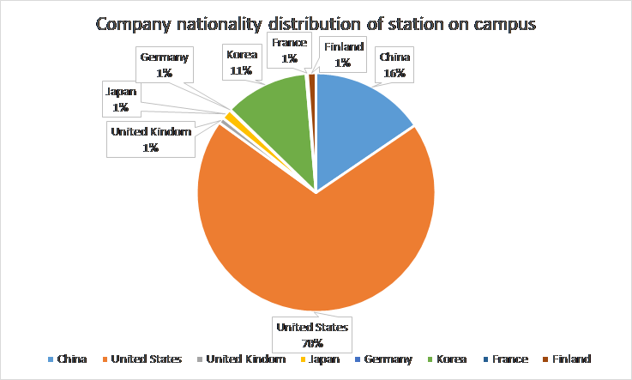
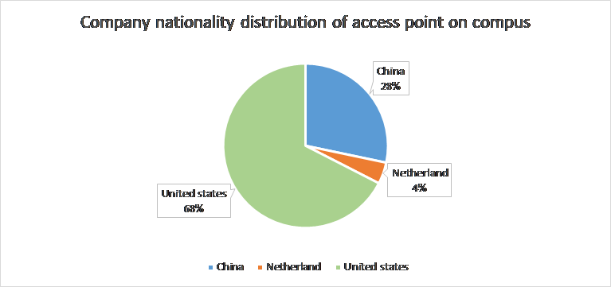
Campus

Slide 6
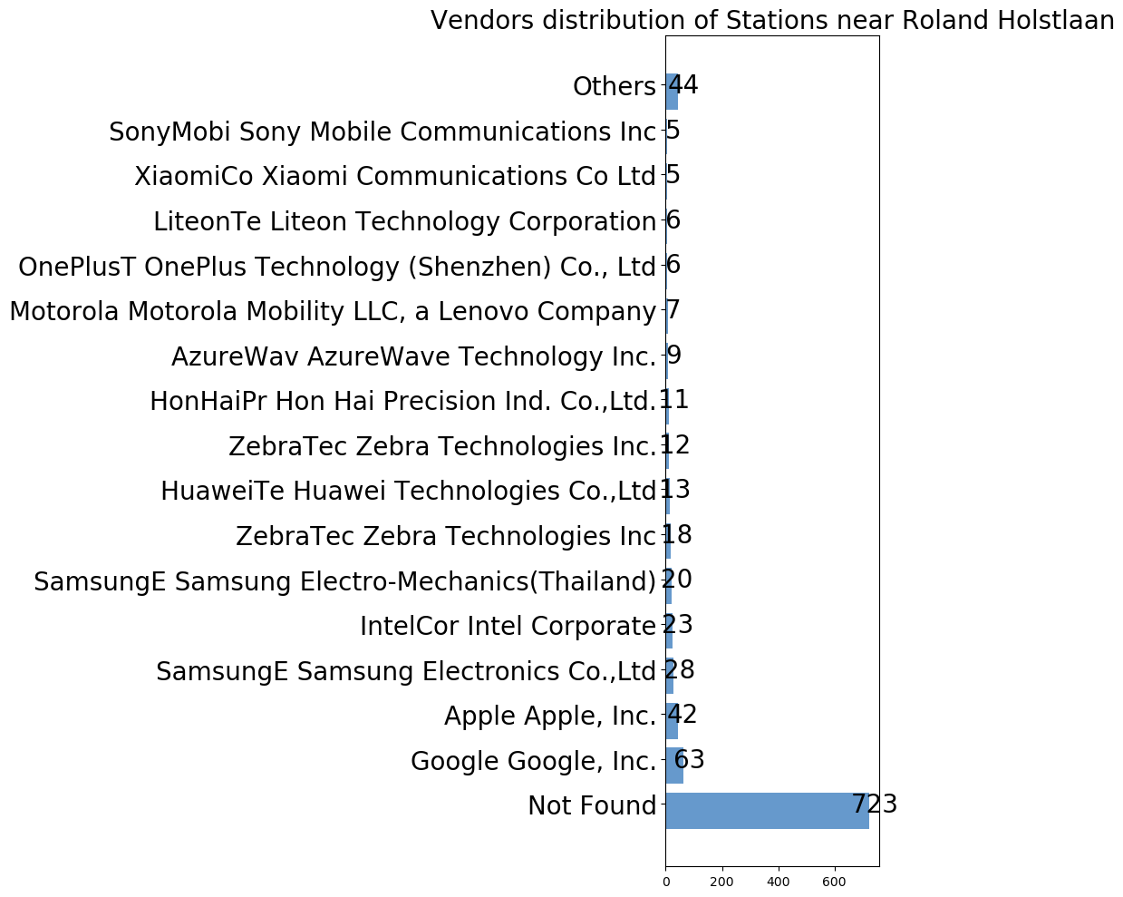
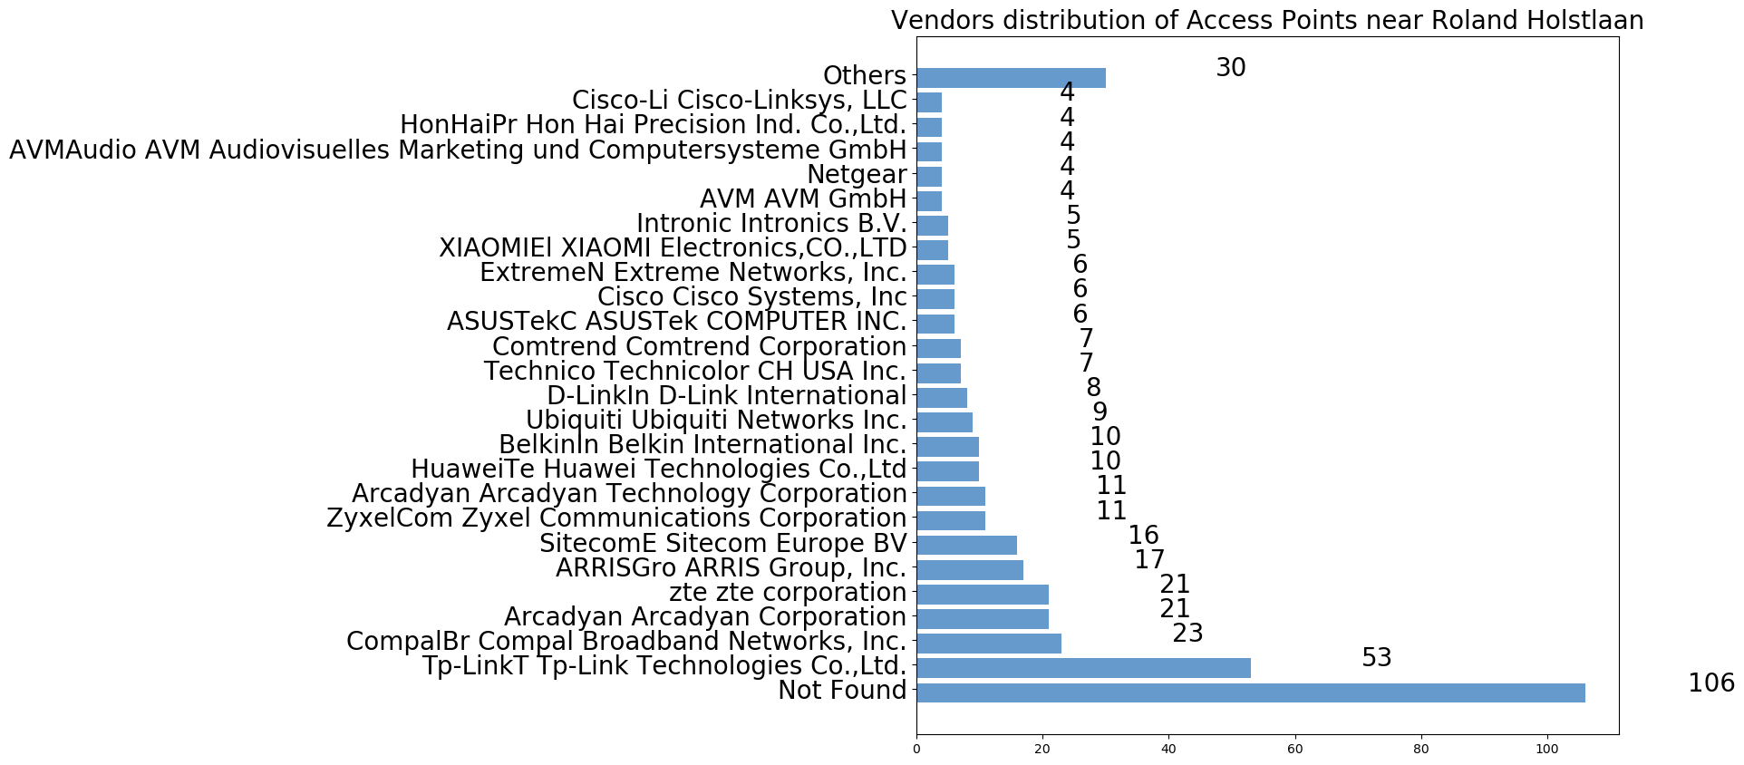
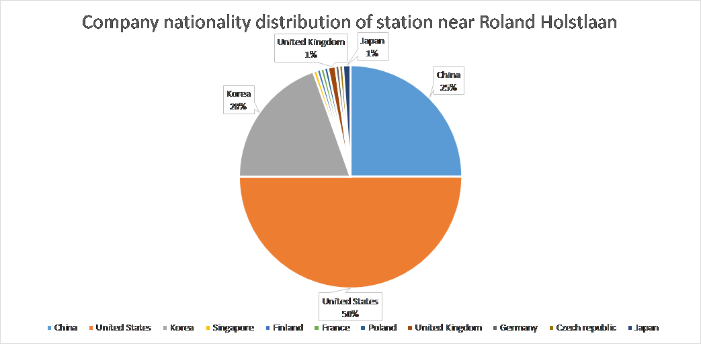
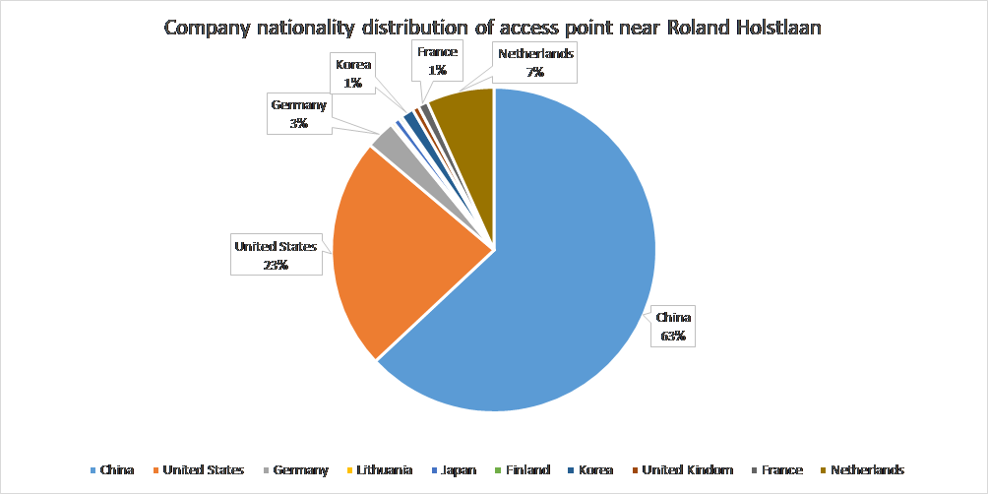
Roland Holstlaan

Slide 7
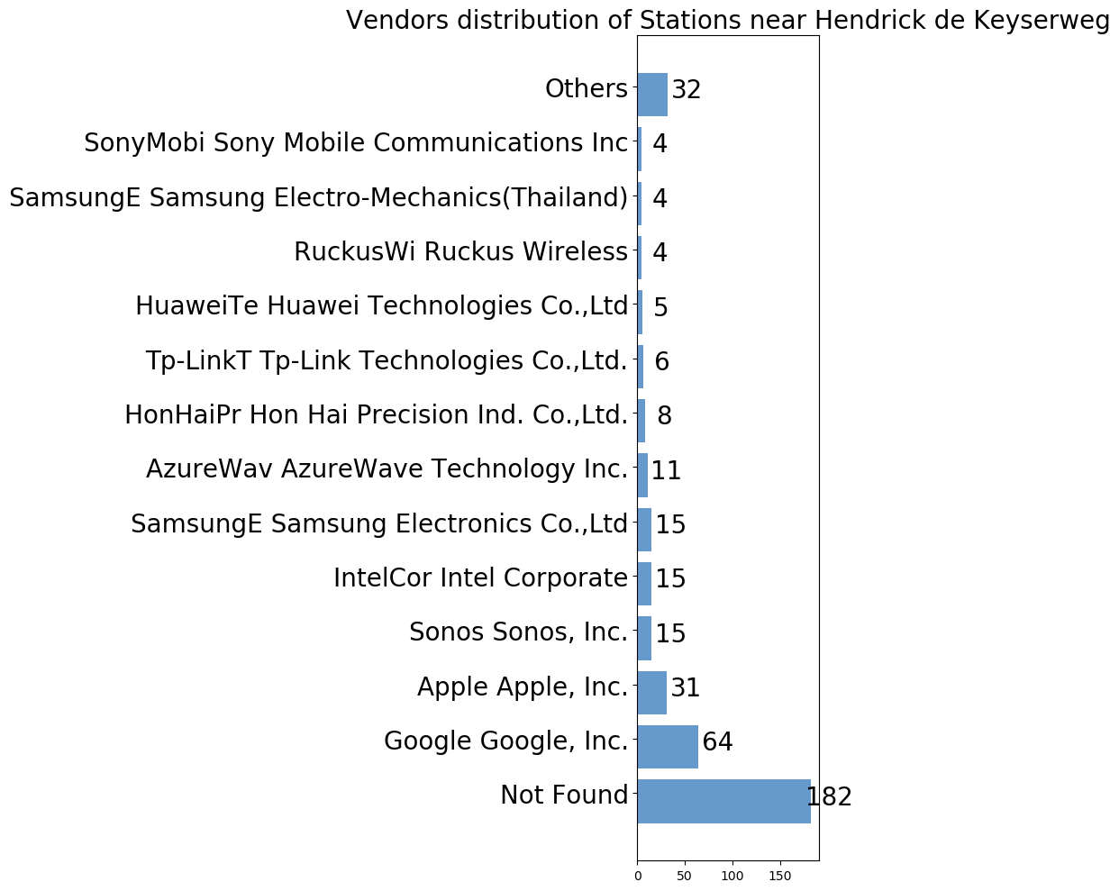
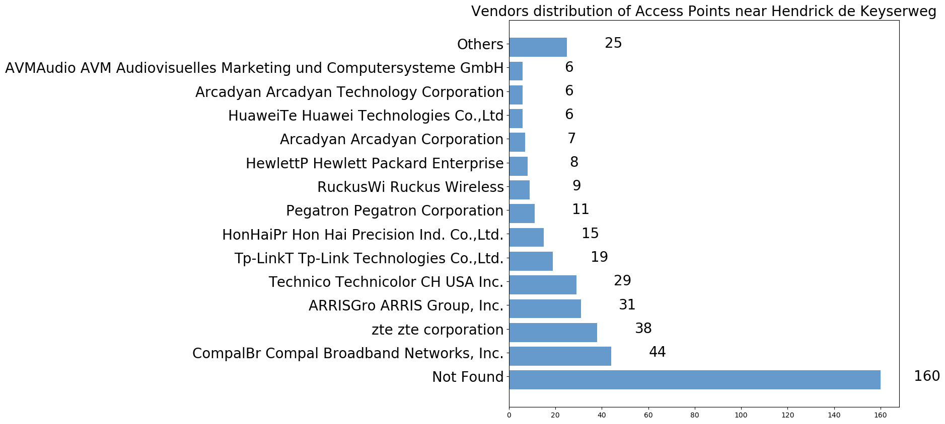
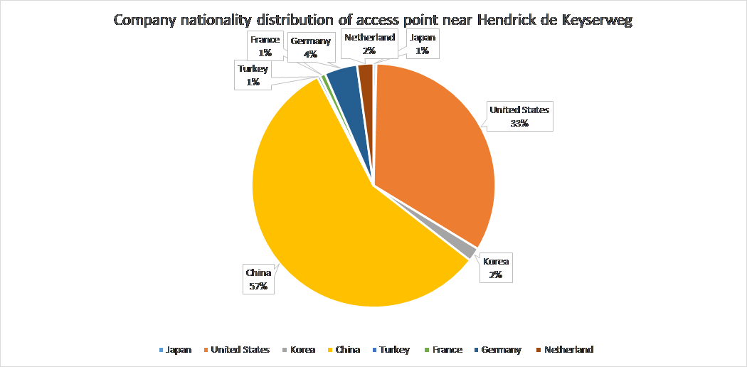
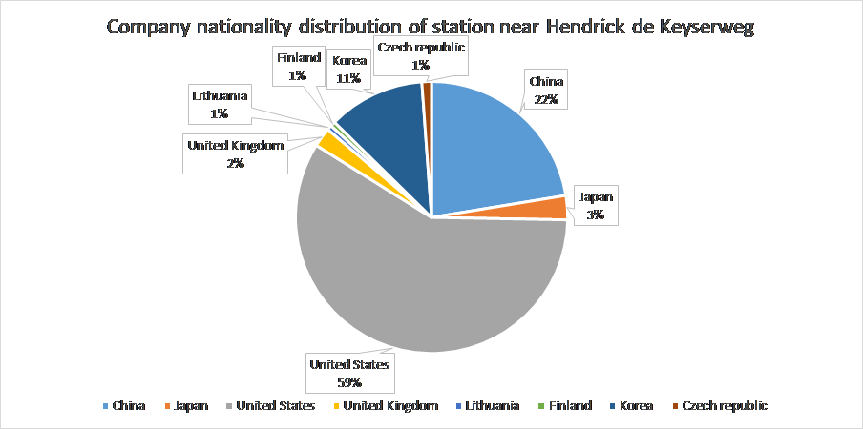
Hendrick de Keyserweg

Slide 8
Conclusion
Still exist many unknown MAC addresses even if apply different database
Requirement of an optimized or daily-updated database for growing number of MAC addresses
Chinese and American companies lead the market of vendors for both access points and stations
Companies in some countries may have an advantages in vendors at one end(such as Korean in stations, Netherlands in access points etc.)

Slide 9
Thank you!

Slide 10

Any question?

